Slide 1
BS6207 Homework 1
3rd April 2021
Isaac Lin

Slide 2


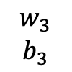

Input Layer
1 x 2
Hidden Layer 1
2 x 10
Hidden Layer 2
10 x 10
Output Layer
10 x 1
x1
$$x$$
y
x2
$$w_{1}$$
$$b_{1}$$
$$w_{2}$$
$$b_{2}$$
$$w_{3}$$
$$b_{3}$$

Slide 3
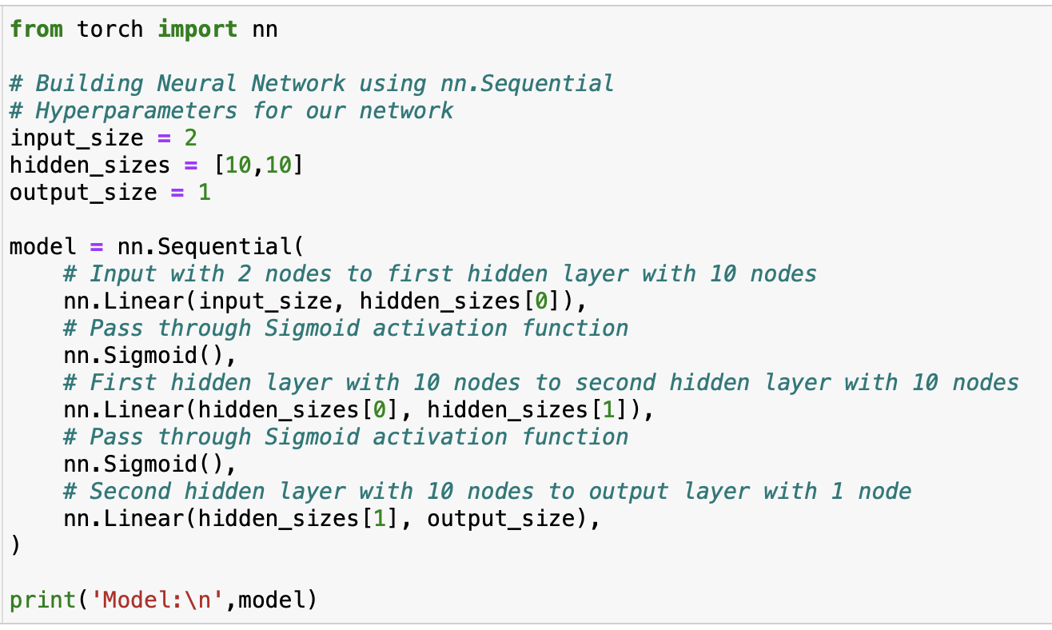
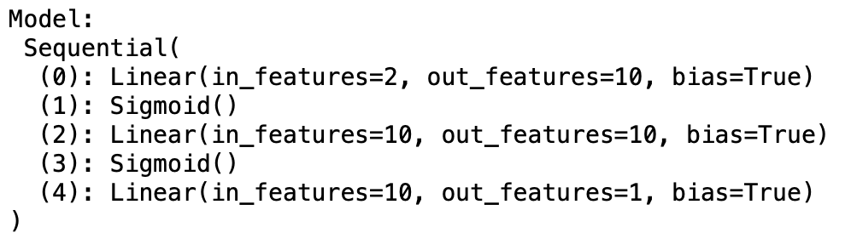
1. Build the model
Using Sequential in Torch
Input Layer with 2 nodes to First Hidden Layer with 10 nodes.
Output is passed through Sigmoid Activation Function.
First Hidden Layer with 10 nodes to Second Hidden Layer with 10 nodes.
Output is passed through Sigmoid Activation Function.
Second Hidden Layer with 10 nodes to Output Layer with 1 node.

Slide 4
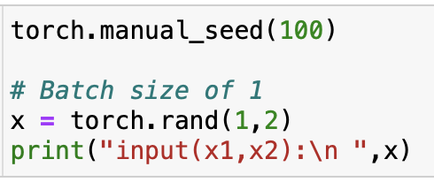

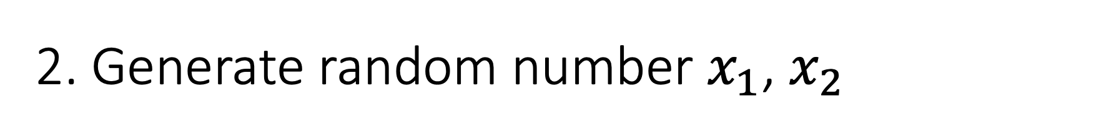
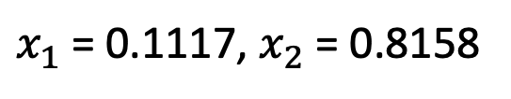
2. Generate random number $x_{1}$, $x_{2}$
$x_{1}$ = 0.1117, $x_{2}$ = 0.8158

Slide 5
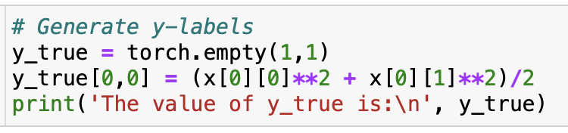


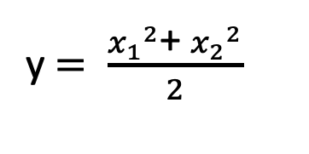
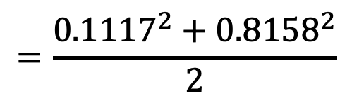
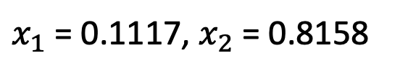
3. Generate the y label
$x_{1}$ = 0.1117, $x_{2}$ = 0.8158
y $= \frac{{x_{1}}^{2}\text{+ }{x_{2}}^{2}}{2}$
$$=\frac{{0.1117}^{2}+{0.8158}^{2}}{2}$$
$$=0.3390$$

Slide 6
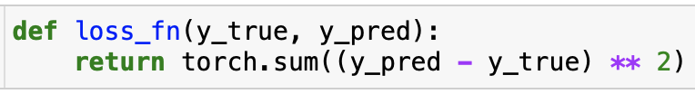
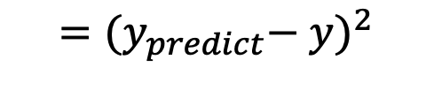
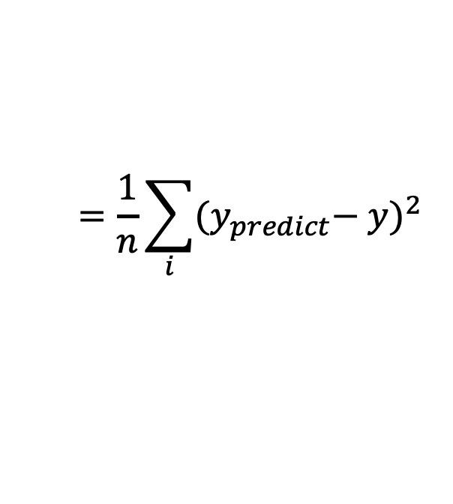
4. Build a loss function
Loss
$$=\frac{1}{n}\sum_{i}{{{(y}_{predict}− y)}^{2}}$$
General equation
$$={{(y}_{predict}− y)}^{2}$$
Batch = 1

Slide 7
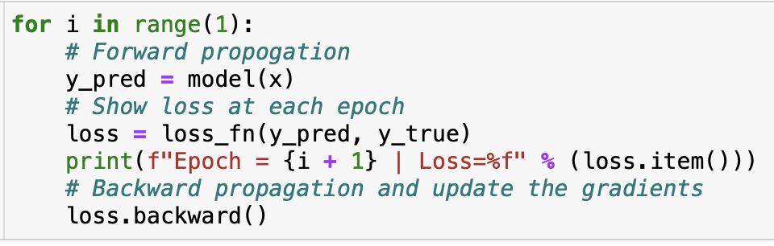

5. Forward / Backward Propagation
Using Torch
Range is set to 1 because we are doing only 1 epoch.
Forward propagation is done by feeding the input x into the model I have built in Step 1.
Loss is calculated as the sum of squared differences between the actual output and the predicted output.
The loss is fed back into the back propagation to update the weights.
Predicted y = -0.6125
After 1 epoch
True y = 0.3390

Slide 8
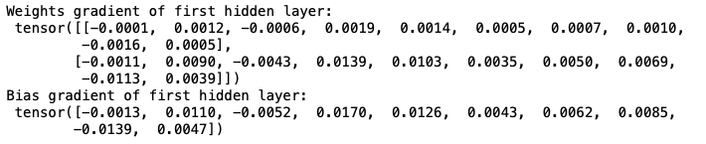
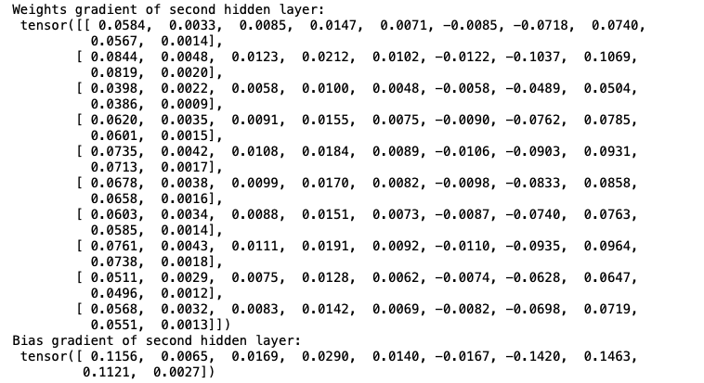
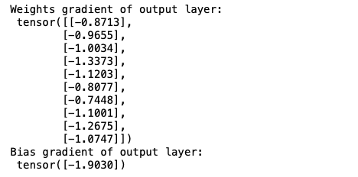






6. Calculate dL/dw and dL/db
$w_{1}$ = 2 x 10
$b_{1}$ = 1 x 10
$w_{2}$ = 10 x 10
$b_{2}$ = 1 x 10
$w_{3}$ = 10 x 1
$b_{3}$ = 1 x 1

Slide 9
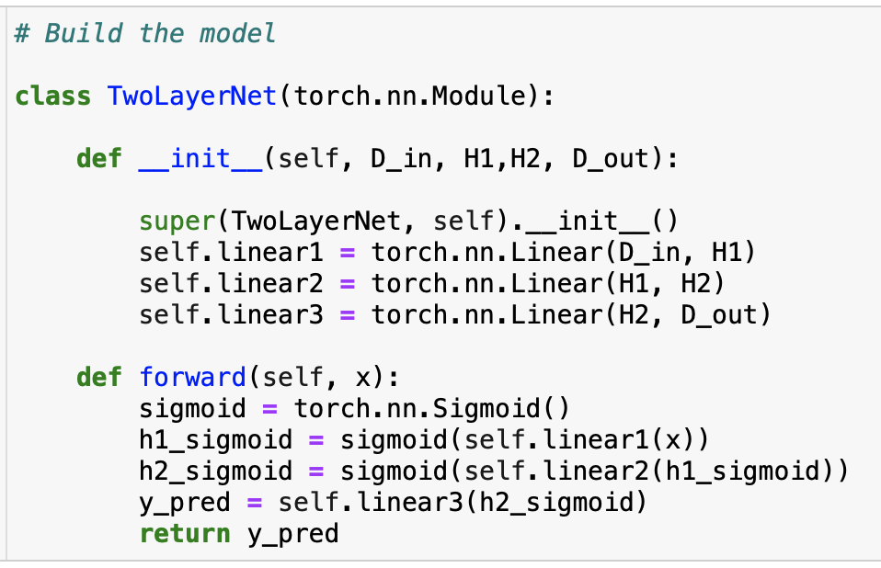
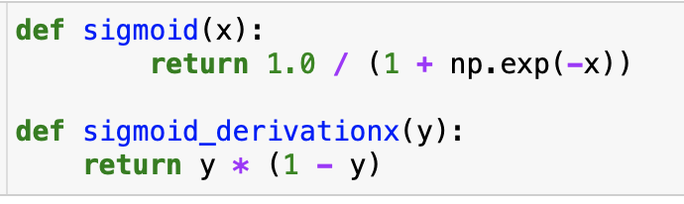
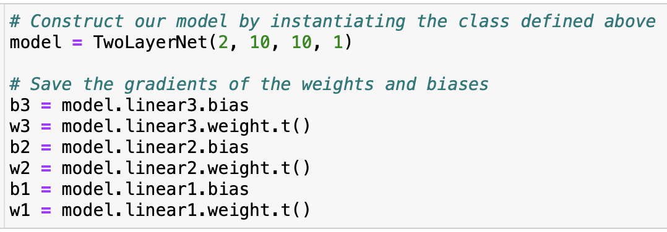
7. Build model (Initialization)
Build model
I build the model the same as in question 1. The model is initialized using Torch for me to find the weights of the gradients more easily later.
Initialize the model
Store gradients of weight and biases in a variable for easy access later
Define sigmoid and sigmoid derivative functions

Slide 10
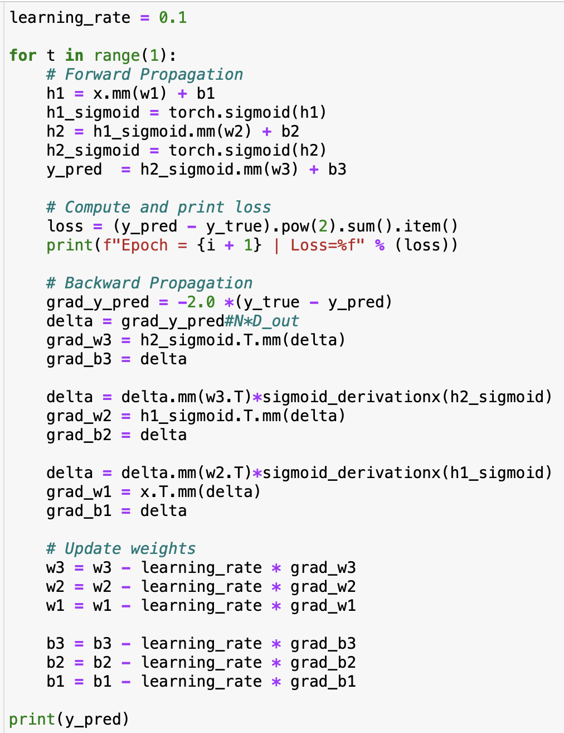
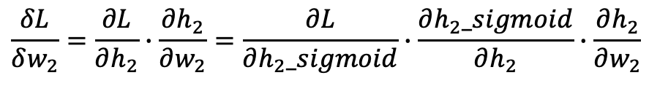
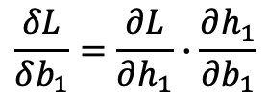

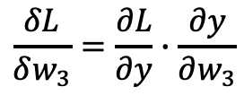
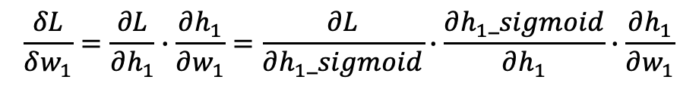



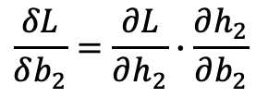

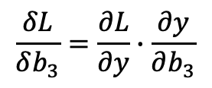
7. Build model (Propagation)
Backward Propagation
$$\frac{δL}{δw_{3}}=\frac{∂L}{∂y}∙\frac{∂y}{∂w_{3}}$$
Forward Propagation
$$\frac{δL}{δb_{3}}=\frac{∂L}{∂y}∙\frac{∂y}{∂b_{3}}$$
$$h_{1}=x∙w_{1}+b_{1}$$
$$\frac{δL}{δw_{2}}=\frac{∂L}{∂h_{2}}∙\frac{∂h_{2}}{∂w_{2}}=\frac{∂L}{∂h_{2}_sigmoid}∙\frac{∂h_{2}_sigmoid}{∂h_{2}}∙\frac{∂h_{2}}{∂w_{2}}$$
$$h_{1}_sigmoid=σ(h_{1})$$
$$h_{2}=h_{1}_sigmoid∙w_{2}+b_{2}$$
$$\frac{δL}{δb_{2}}=\frac{∂L}{∂h_{2}}∙\frac{∂h_{2}}{∂b_{2}}$$
$$h_{2}_sigmoid=σ(h_{2})$$
$$\frac{δL}{δw_{1}}=\frac{∂L}{∂h_{1}}∙\frac{∂h_{1}}{∂w_{1}}=\frac{∂L}{∂h_{1}_sigmoid}∙\frac{∂h_{1}_sigmoid}{∂h_{1}}∙\frac{∂h_{1}}{∂w_{1}}$$
$$y=h_{2}_sigmoid∙w_{3}+b_{3}$$
$$\frac{δL}{δb_{1}}=\frac{∂L}{∂h_{1}}∙\frac{∂h_{1}}{∂b_{1}}$$
Weights are updated by the learning rate.

Slide 11
7. Calculate dL/dw and dL/db
Predicted y = -0.6125
After 1 epoch
True y = 0.3390
Both methods gives me precision values of up to 4 decimal places.

Slide 12
Thank You

